Slide 1

Gender Pay Gap Analysis
Project 3 – KU Data Analytics Bootcamp
Presented by: Sarika Sharma, Ariana Breck, and Jenny Zapata

Slide 2
Contents
01 Project Introduction
02 Project Objective
03 Data Source
04 Data Description
05 Data Overview
06 Data Manipulation
07 Tech Stack
08 Key Visualizations
09 Personas
10 Factors Contributing to the Gap
11 Insights and Findings
12 Addressing the Pay Gap
13 Conclusion
14 Q&A / Discussion

Slide 3

Project Introduction
The gender pay gap refers to the difference in average earnings between men and women. It illustrates how much less women earn than men on average across different industries, roles, and experience levels.

Slide 4

Project Objective
We chose to analyze the gender pay gap for this project because it’s a pressing societal issue with implications on economic equality, workforce diversity, and talent retention.
By examining differences in earnings between genders, we can provide insights that help businesses and policymakers allocate budget/resources to address disparities and promote fairness.
This analysis also helps highlight specific industries or roles with larger gaps, informing targeted actions for equal pay.
Additionally, visualizing this data can create awareness and foster discussions on the importance of gender equity in the workplace.

Slide 5
Data Source
Source - https://www.kaggle.com/datasets/nilimajauhari/glassdoor-analyze-gender-pay-gap
The dataset we chose originates from Glassdoor, a well-known platform that aggregates and anonymizes employee data on salaries, job titles, and employer ratings across various industries. The data collected includes details on employee pay across genders, offering insights into wage differences by industry, position, and more.

Slide 6
Data Description
Gender: Employee gender, often male, female, or non-binary, used to analyze pay gaps.
Job Title: The name of the job position (e.g. Data Scientist, Graphic Designer)
Age Category: Age range (e.g., "21-30"), showing trends by life stage.
Age: Age of the employee
Performance Evaluation: Job performance rating (e.g. "1" as high and "5" as low), impacting pay and promotions.
Dept: Employee’s department (e.g., "Sales" or "Engineering"), indicating job function.
Seniority: Experience level, e.g. Entry represented as "1" and Senior as "5".
Base Pay: Fixed salary excluding bonuses.
Bonus: Additional pay, often annual, for achievements.
Education: Highest completed education level like "College" and "Masters", analyzed for pay correlation.

Slide 7

Data Overview
The reason we chose this dataset is because it includes relevant information like job titles, years of experience, and industry types, which allows us to examine multiple factors affecting pay disparities. Additionally, Glassdoor’s platform is widely used, so the dataset reflects real-world conditions and diverse employment environments, providing a reliable foundation for our analysis.

Slide 8
Data Manipulation
Populated Age Category - The data manipulation process involves categorizing each employee’s age into specified ranges (e.g., 21-30, 31-40). The Age data is very thinly sliced which makes it hard to visualize any wage differences on such small slices. To bypass this issue, we created a new column in the data frame to categorize data for better visualization.

Slide 9





Tech Stack
SQLAlchemy is the Python SQL toolkit for connecting to relational databases and provides abstraction at database level. We used it for creating an engine to connect with the postgres database.
Postgres
PostgreSQL is a robust open-source database that extends SQL and is designed to safely store and scale complex data. We used it to store our structured salary data locally so that it can be easily retrieved and manipulated for the project.
Flexible and powerful data structures that make working with labeled or relational data easy and intuitive. We used pandas to validate data for null values, filter data, and to add additional attributes for effective visualizations.
Seaborn is a Python library for creating clear and appealing statistical graphics. It provides API to create visually appealing plots for data that shows complex relationships. We used it to create heat maps and colorful scatter plots to show the multifaceted nature of pay gap.
Matplotlib is an extensive library designed for building a wide range of visualizations, including static images, animations, and interactive graphics. We used it to create and customize the display of plots.

Slide 10




Tech Stack
Flask is a lightweight, Python-based web framework used to build web applications quickly and efficiently. It was used as a backend framework to setup and manage Rest API routes to serve HTML templates allowing the users to interact with the dashboard. We used its jinja template engine to render HTML on web browser.
HTML (Hyper Text Markup Language) and CSS (Cascading Style Sheets) are the foundational technologies for creating and styling web pages. We used HTML and CSS to create the front-end interface of our dashboard. HTML builds the structure, while CSS provides styling, enabling users to interact with the dashboard, submit inputs, and view results in a visually cohesive and user-friendly way.
Jupyter is an open-source tool that allows users to create and share interactive notebooks containing live code, equations, visualizations, and text. It was used as a sandbox in our project for data exploration and to see visualization results.

Slide 11
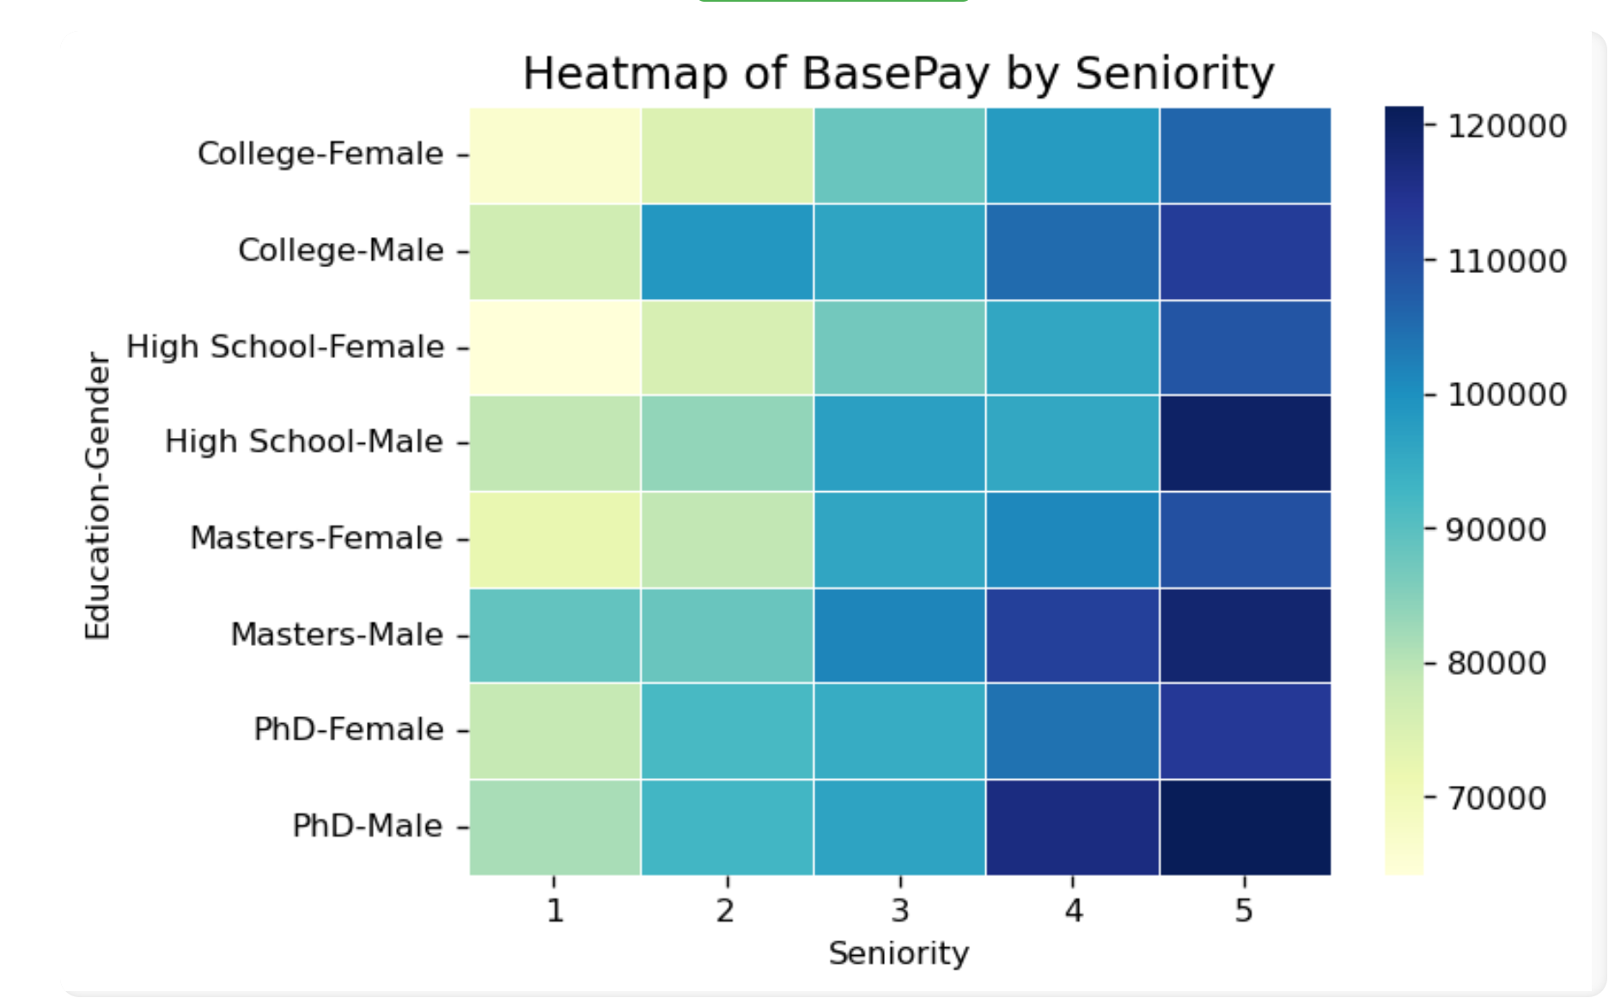
Key Visualizations
This image is a heatmap visualizing base pay across different education levels and gender taking seniority as a metric to compare.
The color intensity represents base pay, with lighter colors indicating lower salaries and darker colors representing higher salaries.
The color bar on the right provides a scale for interpreting the salary values, ranging from around 40,000 to over 140,000 dollars.

Slide 12
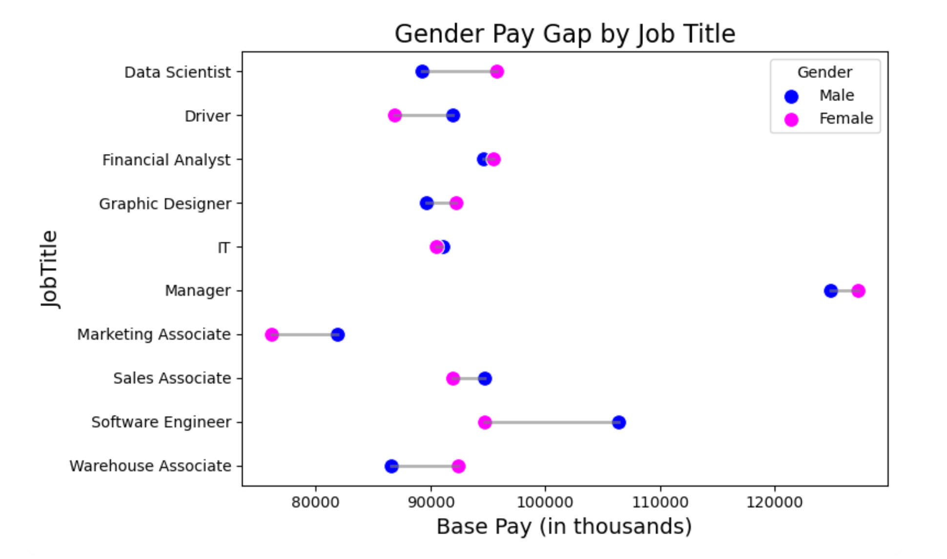
Key Visualizations
This image is a dumbbell plot that compares salaries between male and female employees across different Job Titles.
The plot suggests that some roles have a noticeable pay gap, while others show little to no difference.
Software Engineer and Warehouse Associate positions display a significant pay gap, with males earning higher base pay than females.
Marketing Associate and Sales Associate show minimal pay gap between genders.
IT stands out as the Job Title with the least gender pay disparity, indicating more equitable salaries between male and female employees there.

Slide 13
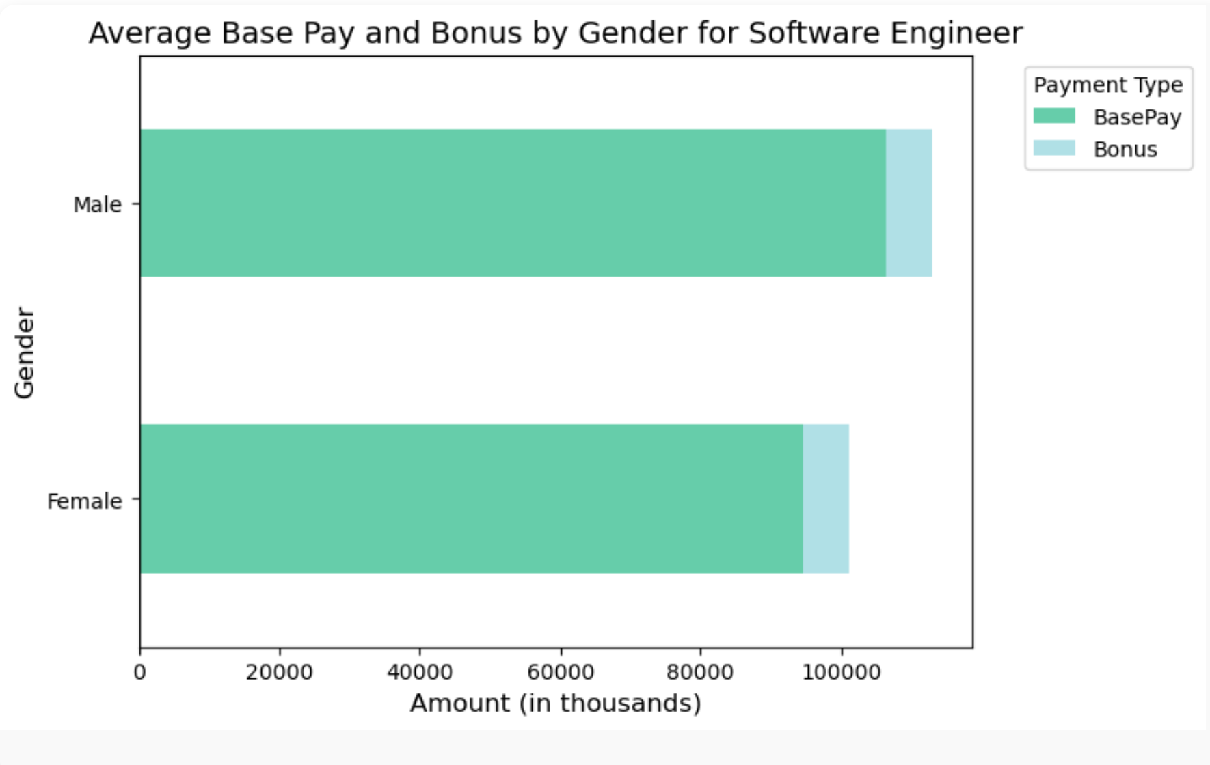
Key Visualizations
This image is a horizontal stacked bar chart comparing base pay and bonuses for males and females for the Software Engineer Job title.
The male bar has a longer green segment, suggesting that males receive a higher base pay compared to females. However, the bonus appears to be in the similar range for both.
This visualization proved to be an eyeopener breaking the assumption of pay parity in this tech industry job title, highlighting the need for broader analysis and careful consideration of reasons for the disparities.

Slide 14

Persona
Persona: Sarah Thompson
Age: 34
Occupation: Human Resources Manager
Education: Master’s Degree in Human Resources Management
Location: Chicago, IL
Sarah has over 10 years of experience in human resources, specializing in employee engagement and diversity initiatives. She works for a mid-sized tech company that values transparency and equality in the workplace. Sarah is passionate about creating an inclusive environment and addressing systemic issues related to pay disparities.
Sarah’s goal is to understand the pay structure within her organization and identify any discrepancies between male and female employees.
USER SCENARIO
Sarah logs into the dashboard to analyze salary and compensation trends across different roles within her company. She selects various job titles and creates visualizations that reveal any disparities.
She can assess if pay discrepancies are tied to specific roles or job titles, which can inform role-based pay equity adjustments.
See if compensation differences align with years of experience across genders, identifying any inconsistencies in pay progression.
With this information, she prepares a presentation for her management team, highlighting the need for policy changes to promote pay equity.

Slide 15

Persona
Persona: Ella Stuart
Age: 16
Occupation: High School Student
Education: Junior Year, enrolled in AP Courses – Calculus, Physics and Statistics
Location: Lawrence, KS
Ella is a high school student passionate about pursuing a career in technology. She is actively involved in her school’s Math, Robotics Club and participates in coding competitions. Ella has a strong interest in understanding how technology careers are structured, including factors like salaries, growth potential, and diversity. As someone who values equality, she is keen on learning about gender pay gaps, especially within tech fields, to understand the dynamics of the industry she plans to enter.
Emma’s goal is to gain insights into salary trends and gender pay disparities in tech-related roles, using this knowledge to make informed career decisions and advocate for fair practices.
USER SCENARIO
Ella logs into the dashboard to explore gender pay gaps in tech job roles.
She understands how higher degrees affect salaries in tech fields and discrepancies between male and female employees with similar qualifications to decide if higher education impacts pay equity.
She identifies roles with the most significant pay gaps, providing her with real-world comparative insights into the tech industry at a glance.
She explores what to expect in terms of salary and bonuses for the roles she is interested in. She uses this information to understand the typical earning potential in tech and any evident disparities.

Slide 16

Persona
Persona: Alex Chen
Age: 21
Education: Junior at State University, majoring in Business Analytics
Background: Alex is in his third year of college, with a growing interest in data science and analytics. He taken courses in Python, data visualization, and gender studies. Alex wants to work as a data analyst after graduation and is particularly interested in exploring how data can uncover trends in workplace equality.
Goal: To understand and analyze data on gender pay disparities across different job roles, departments, and education levels.
Alex would log in to the dashboard to explore real-world data on gender pay disparity. Since Alex is working on a research paper about workplace equality and wants hands-on experience with data, the dashboard offers both educational insights and practical tools for analysis.
The dashboard's interactive options help Alex see if certain job titles or departments have consistent disparities.
By comparing pay across education levels, Alex might observe whether higher education levels lead to more equitable pay or if disparities persist.
Alex could present this information in class projects, to raise awareness among peers, or in student groups interested in social justice and workplace equality.

Slide 17
Factors Contributing to the Gap
Influence of Experience and Education
Experience: Data analysis shows that as experience increases, salary gaps tend to widen in certain fields. This could be due to differences in career progression opportunities and access to higher-level positions.
Education: Higher educational levels correlate with increased salaries, but gaps persist within similar education brackets, suggesting systemic biases.
Examples of Roles/Industries with significant differences
Technology: Shows a moderate to high pay gap, particularly at senior levels, where fewer women reach high-paying roles.
Engineering: The gender pay gap in engineering is a notable issue, with female engineers generally earning less than their male counterparts. Despite similar education and experience levels, women in engineering often face pay disparities due to factors such as slower career progression, and biases in performance evaluations.

Slide 18
Insights and Findings
Patterns & Trends -
Role Progression: At entry-level, gaps tend to be smaller, but they widen as roles advance, suggesting that promotion rates or raises may differ by gender.
Experience Impact: More years of experience generally correlate with higher pay for all, but the gap often widens with experience, especially in male-dominated fields.
Unexpected Findings
Minimal Gaps in Some Sectors: Jobs in IT show minimal gap or even a reversed gap is noticed in Data Science and Financial Analysis, possibly due to established pay scales or greater gender diversity.

Slide 19
Addressing the Pay Gap: Policies & Benefits
Policy Recommendations
Salary Transparency: Implement clear pay disclosure policies to reduce disparities and promote accountability.
Equity-Focused Training: Provide leadership training on unbiased hiring, evaluation, and promotion practices to combat systemic biases.
Standardized Pay Scales: Create pay scales based on role, experience, and location for consistent compensation across genders.
Benefits of Addressing the Pay Gap
Attracting Diverse Talent: Prioritizing equitable pay attracts a broader demographic, enhancing creativity and innovation.
Enhanced Reputation and Retention: Fair pay practices boost employee morale and loyalty, improving public image and reducing hiring costs.
Boosted Productivity: Diverse teams with equitable compensation are often more productive, leading to better organizational performance.

Slide 20
Conclusion
The Gender Pay Gap Analysis dashboard is both an accessible and informative web app for users of all levels, from beginners like students to experienced professionals like HR managers. Beginner users can navigate and interact with the dashboard effortlessly due to the intuitive layout and simple interface. Advanced users can use the detailed visualizations and data insights for in-depth analysis, reporting, or decision-making.
Key Highlights
Simple and flexible - Easily modifiable in response to user needs.
Structured, consistent, and visually clear interface - Easy and intuitive interaction.
Reliability and Scalability - Fast data retrieval, data security and handling of large datasets handled without slowing down.
Summary overviews and in-depth analysis - Handles complex calculations, e.g. calculating average salaries by gender or creating specific data subsets and pivots efficiently.
Customization to accommodate all types of users – Adjustment of colors, labels, and scales to create clear, attractive, and effective visualizations that represent complex data relationships via easy-to-understand graphs like heat maps.
It makes data-driven decision-making accessible to everyone.

Slide 21

Q&A / Discussion

